Slide 1


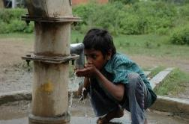

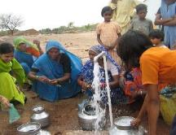

Madhya Pradesh Jal Nigam
Jal Rekha
2nd December 2025

Slide 2

Digital Project Monitoring Initiatives
For MP Jal Nigam By MPSeDC
Jal Rekha
Low cost Make in India Initiative
Agenda

Slide 3
Digital Project Management - Jal Rekha
“Jal Rekha” is a GIS based tool which can be easily accessible via android & web application to monitor and management of the progress in MVS (Multi Village Water Supply Schemes) under JJM in Madhya Pradesh.
Precise Asset Tracking : Real time location tracking of assets installed and parallel visual comparison with approved designs.
Ingenious Quality Assurance: Reduce time consumption in inspection procedures and improved work quality through categorized inspections.
Advance Decision Making : Weekly publishing of progress in workplan, inspection and water supply details enables the “Jal Rekha” team to take precise decisions in time.
Partnering Up : Partnering the geographically referenced design & drawing data sets with other departments like Urban, Road, Telecom, MPEB, Domestic Gas Supply agencies etc enables them to receive NOC from respective departments and to execute their plan in time with out creating any fuss.

Slide 4
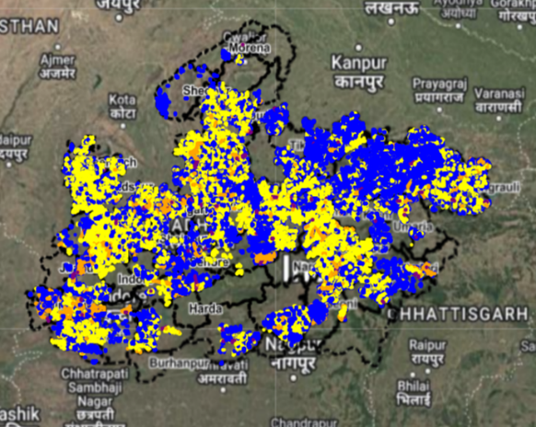
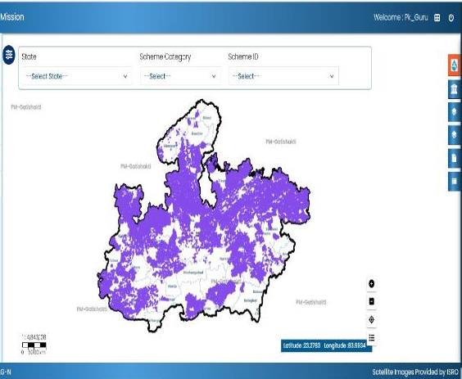
Digital Project Management - Jal Rekha
Information about the MVS assets (Intake Well, WTP, OHT & Supply lines) constructed over the ground are geo-tagged in Jal Rekha application and uploaded on Jal Rekha Portal. These GIS based layers were also successfully uploaded over the PM- Gati Shakti portal through an API.

Slide 5
Digital Project Monitoring Initiatives – Modules Developed
1. Execution
Jal Rekha
Asset Mapping (OHTs, Intake etc)
2. O&M
Dhara (Water Quantity)
Panchayat Darpan
3. Personnel
(HR Mgmt.)
ePrabandhan
Anushravan (RFIs)
ePraman (eMB)
4. General
Jal Samagra
Jal Rekha
Nirmal (Water Quality)
Bulk Water Charges from GPs
Water User Charges from Citizens
SARTHAK
E-Office
Sahbhagita (ISAs)
Sopan
Jal Samadhan
Bharosa

Slide 6
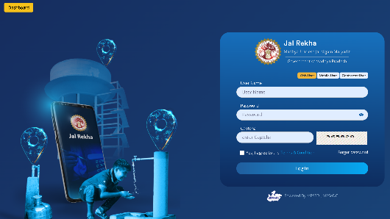
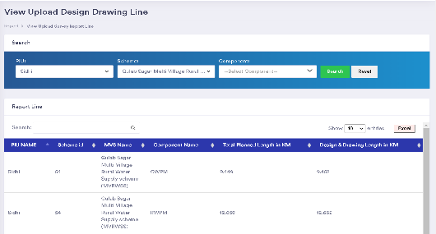
Asset Mapping & Management (GIS-based Modules)
Design and Drawing: All approved components of the schemes viz. Intake Well, WTP, Pipelines, and OHTs are being mapped to the GIS-based portal of Jal Rekha.
Field Survey Data: The geotagged location and photo of the component are being uploaded on the mobile app by the field officers, which shows the actual location of the component.
Data Visualization: Visualize approved design & drawing and updated as-built data on the map.

Slide 7
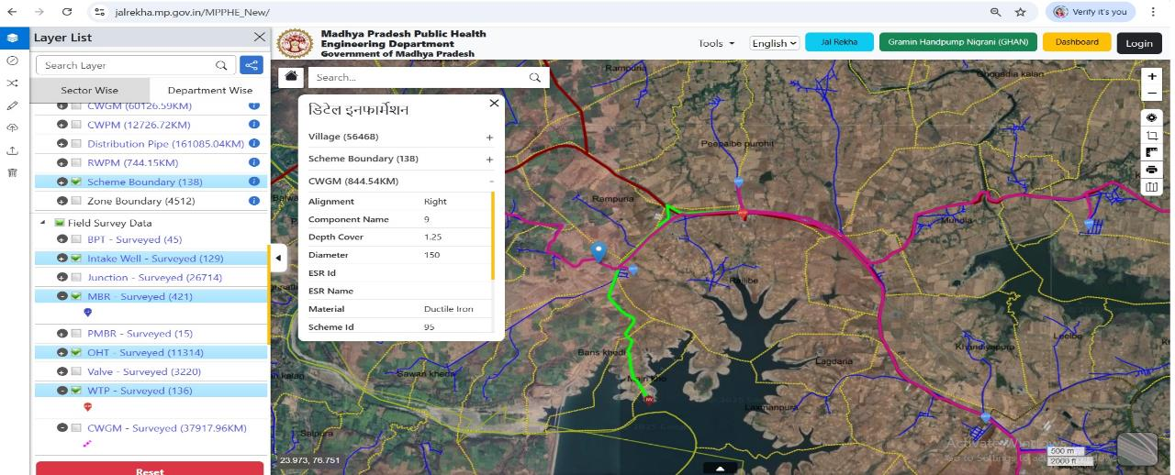
Asset Mapping - Mapping of Pipe Network
Details as on 24.11.25
Planned Length (km) | Uploaded Length (km) | % Progress | Pipeline laid (km) | Surveyed length (km) | % Surveying Progress wrt Laying
2,16,754 | 2,06,234 | 95% | 1,50,286 | 1,24,347 | 83%

Slide 8
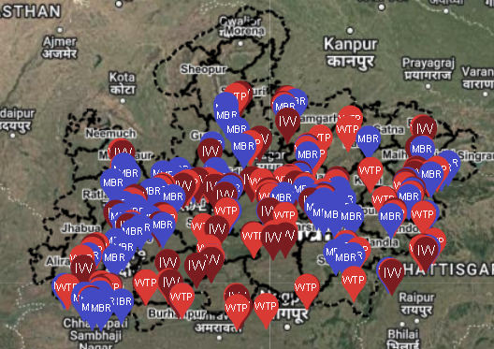
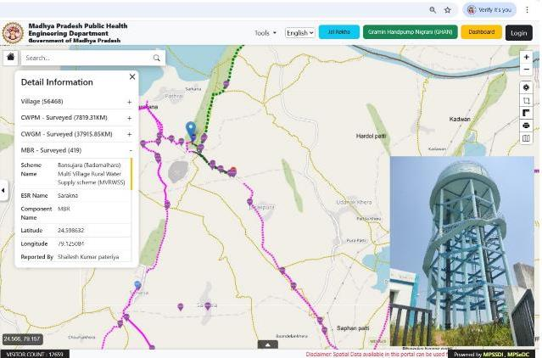



Details as on 24.11.25
Asset Mapping – Mapping of Point data (OHT, MBR, WTP, Intake)
Total Points | Uploaded | % Progress | Executed Qty | Surveyed | % Surveying Progress wrt Execution
12,428 | 11,448 | 92s% | 12,772 | 12,220 | 95%
Legend
 | Intake Well |  | WTP |  | MBR

Slide 9
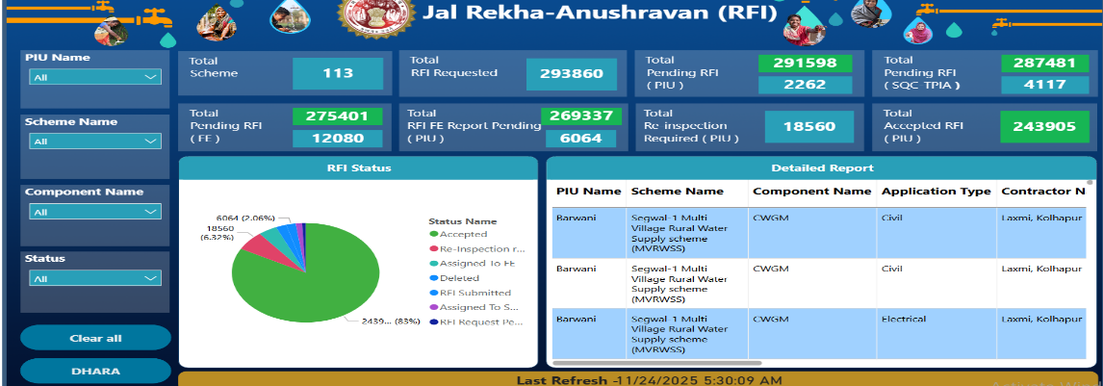
Anushravan Module for “Request for Inspection” for execution monitoring
RFI (Request for Inspection): RFI (Request for Inspection) is submitted by contractors through this application. The RFIs will be assigned by CGMs / GM, PIUs to SQC or TPIA personnel.
Daily Inspection: MPJN officials / Consultants can submit the observations during site visit including geotagged photographs. Contractors needs to address the observations.

Slide 10
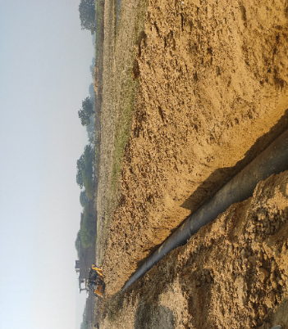
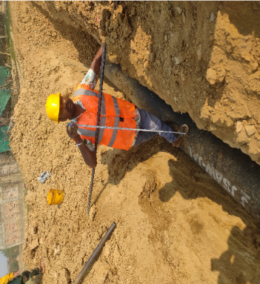
Jal Rekha – RFI
Depth and Alignment checking
Component: CWGM
MVS Name: Tamas MVS
Inspection Date : 30-01-2025
Status : Accepted

Slide 11
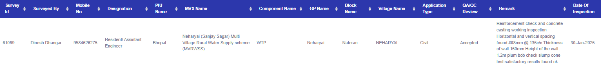
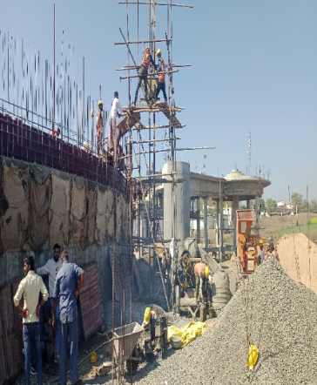
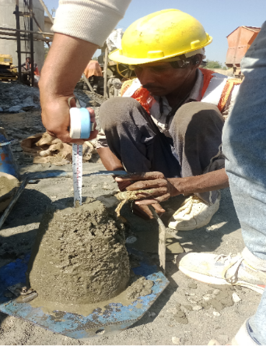
Jal Rekha – RFI
Checking of reinforcement and concrete casting work, vertical spacing, Height of the wall and plum bob check with slump cone test
Component: WTP
MVS Name: Sanjay Sagar (Nehrayi) MVS
Inspection Date : 30-01-2025
Status : Accepted

Slide 12

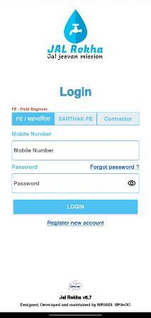
Sahbhagita Module – ISA Activities Monitoring
Sahbhagita Module tracks the activities performed by the Implementation and Support Agencies (ISAs) for awareness generation and information dissemination.
Key Benefits:
Enhanced Monitoring & Supervision
Improved Data Management
Transparency & Accountability
User-Friendly Interface & Accessibility
Strengthening Community Participation

Slide 13
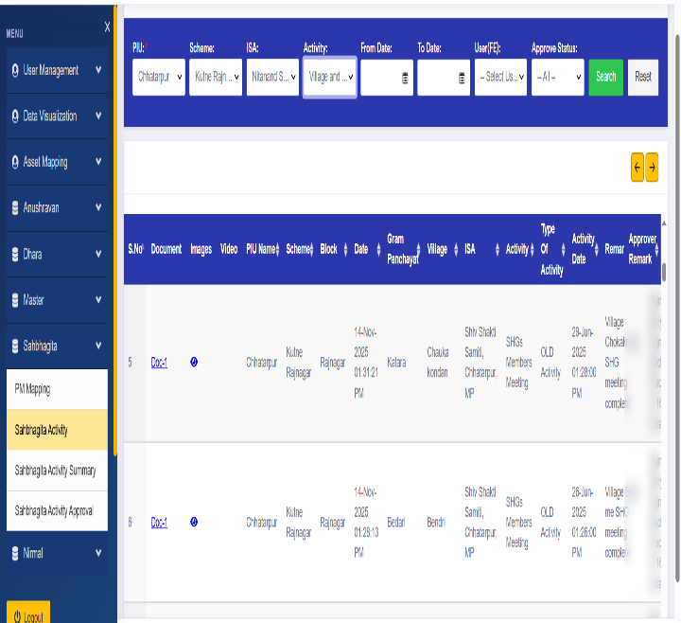
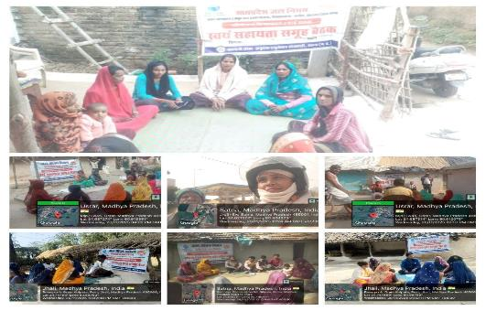
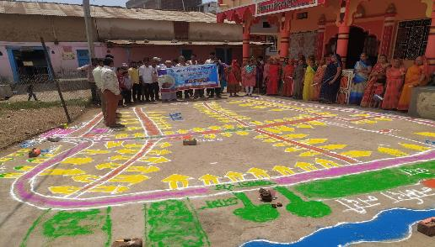
Sahbhagita Module – ISA Activities Monitoring

Slide 14
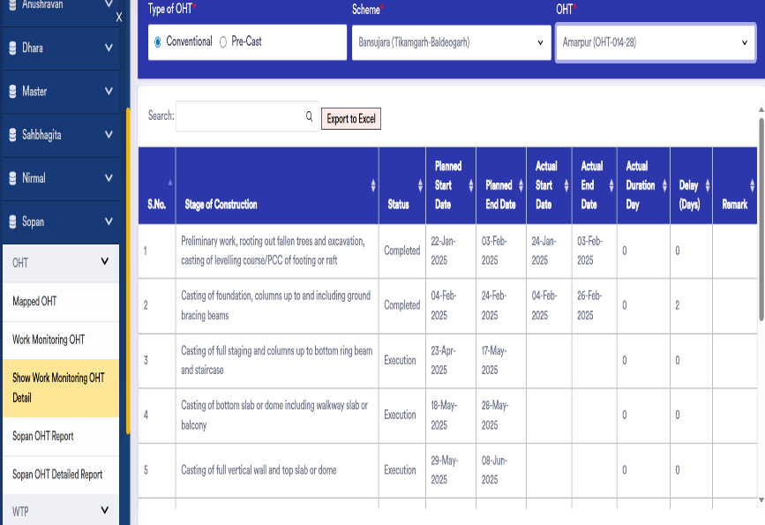
Sopan Module – Construction Work Progress Monitoring of Structures (WTP, OHT etc)
Sopan Module tracks the stage wise activities performed at the time of implementation of Over Head Tanks.
Key Benefits:
Help in track the actual stage of work completed
Track the delays in Stage wise development
Track the financial liabilities procured at site

Slide 15
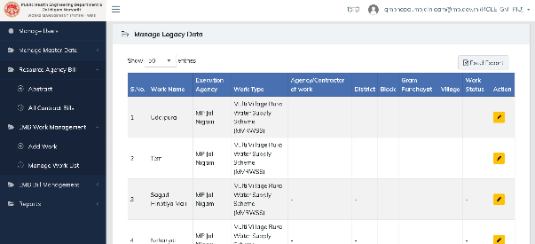
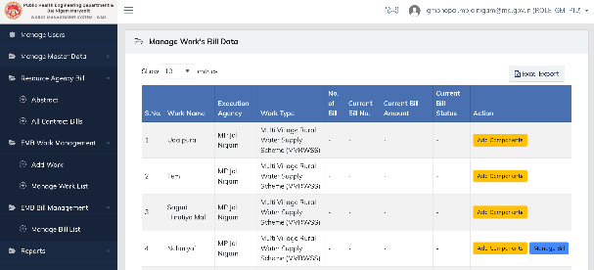
ePRAMAN (eMB)
ePRAMAN integrates a sophisticated system for capturing running bills information across various stages of construction and maintenance.
This solution would capture the lumpsum nature of MPJN contracts and detailed price breakup schedule of various components.
S. No. | Modules | Description
1. | ePRAMAN and Billing | To capture the measurements electronically and keep track record of the running bills as the work progresses.
2. | Documentation | To keep the record of all the relevant documents by uploading with respect to the work.

Slide 16
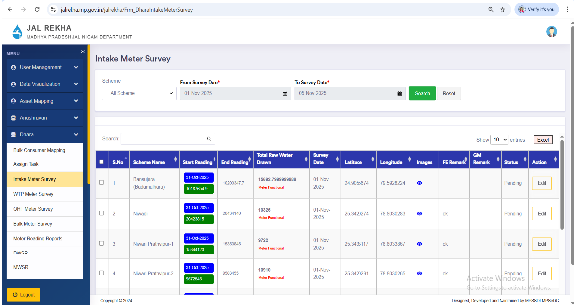
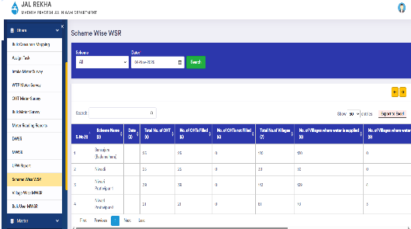
Dhara Module – Water Supply Quantity Monitoring
Dhara module is a crucial component for maintaining and monitoring detailed volumetric data for all water supply schemes.
Daily Water Supply Report (DWSR) is the crucial output from this module on a daily basis.
Collected data is then utilized in the Panchayat Darpan Portal to generate and issue bulk water charges bills to the GPs.
Ensures accurate billing and transparent access to overall water usage information for the contractors as well as users (Gram Panchayats)

Slide 17
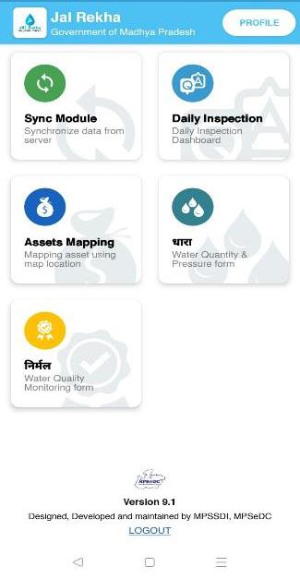
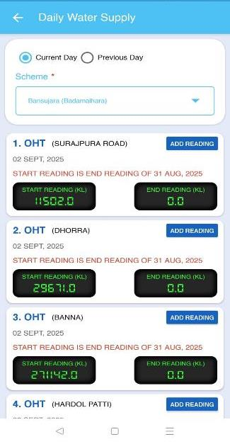
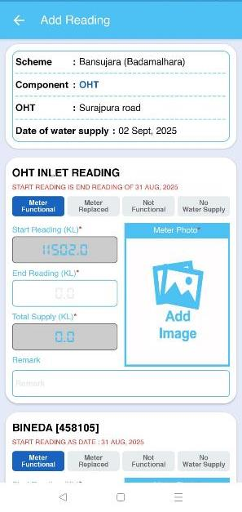
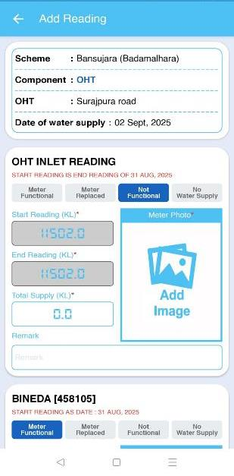
Dhara Module – Water Supply Quantity Monitoring

Slide 18
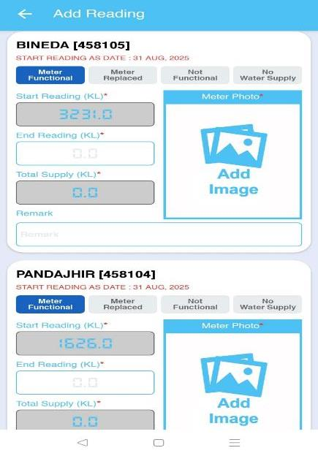
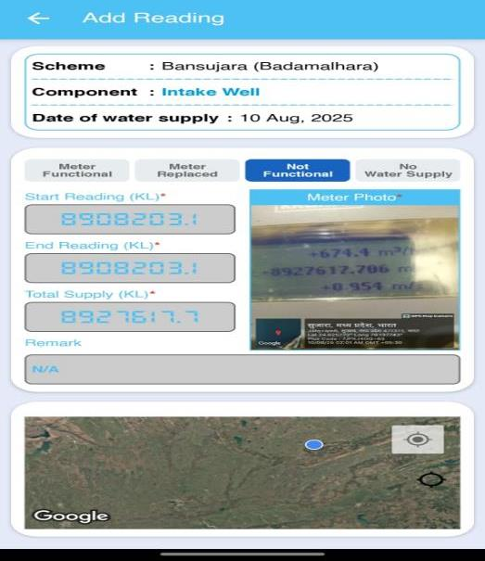
Dhara Module – Water Supply Quantity Monitoring

Slide 19
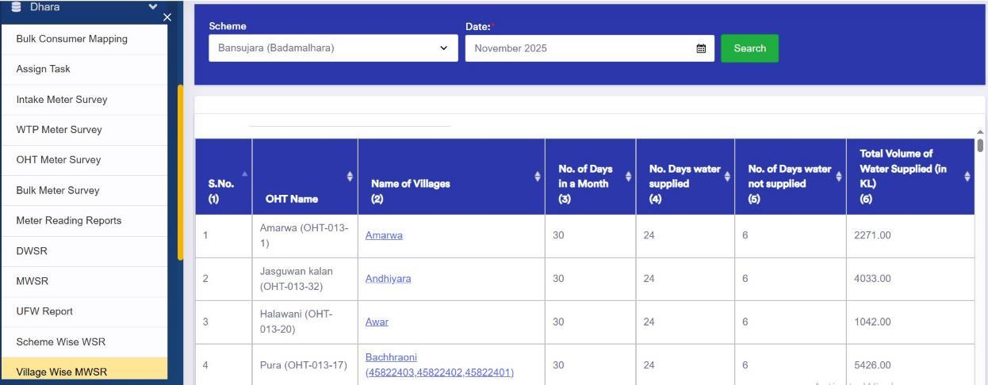
Dhara Module – Water Supply Quantity Monitoring

Slide 20
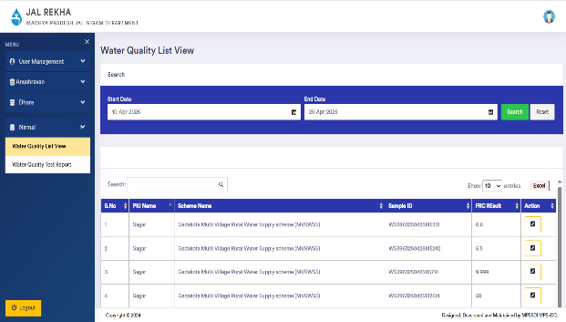
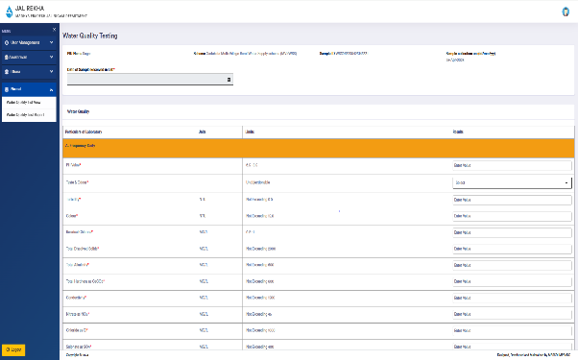
Nirmal Module – Water Quality Monitoring
Nirmal: Nirmal module is developed to assess and monitor the quality of water supplied by the schemes, to ensure that the water supplied meets various quality standards. Regular testing ensures drinking water supply as per BIS:10500 in the planning area.

Slide 21

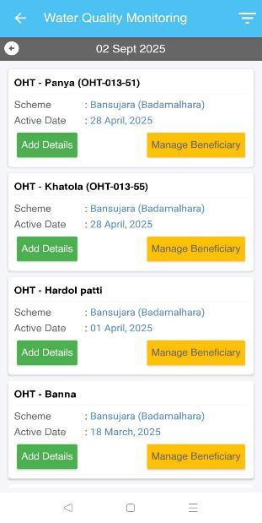
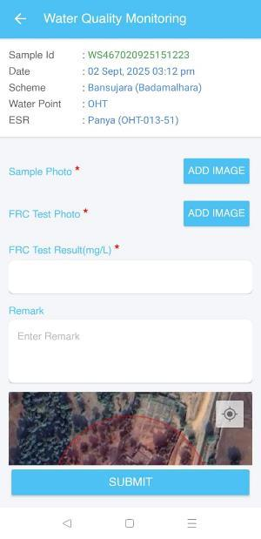
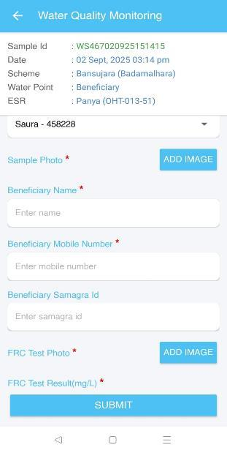
Nirmal Module – Water Quality Monitoring

Slide 22
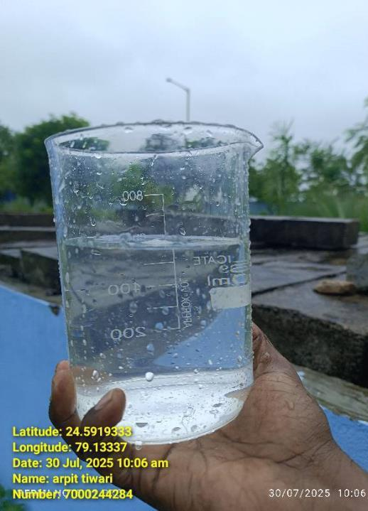
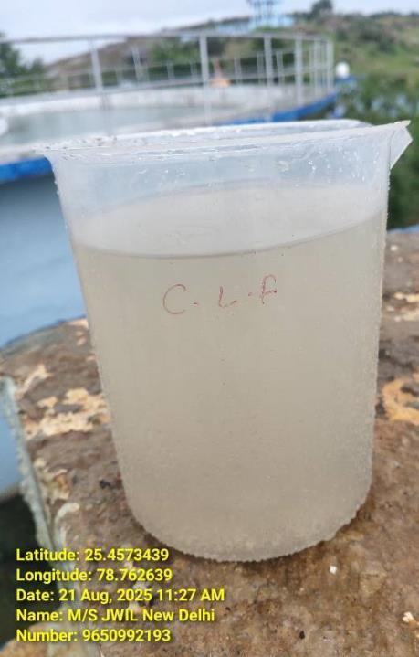
Nirmal Module – Water Quality Monitoring
Clear water Sample at WTP
&
Raw Water Sample at Inlet WTP

Slide 23
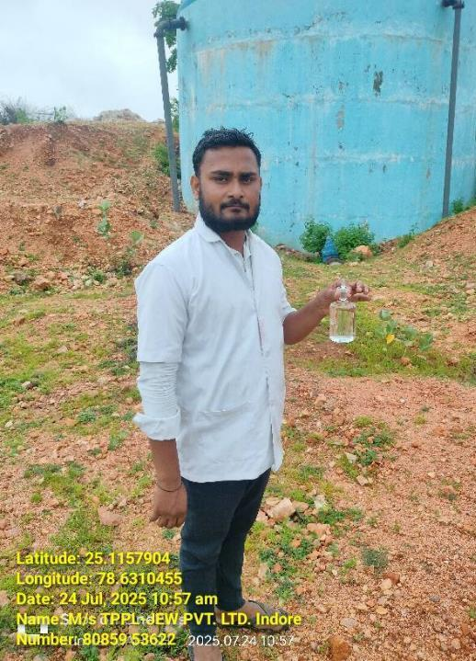
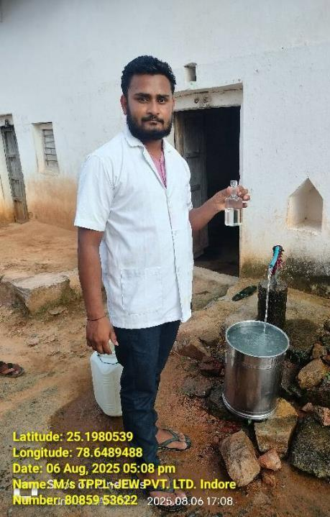
Nirmal Module – Water Quality Monitoring
Sample at OHT
&
Beneficiary at Village

Slide 24
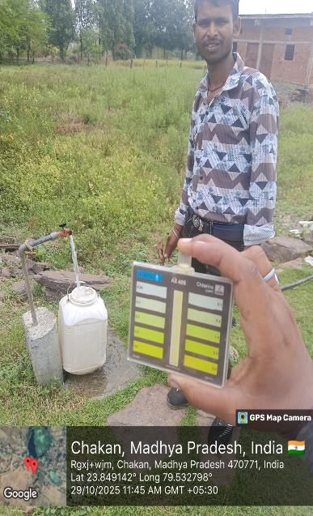
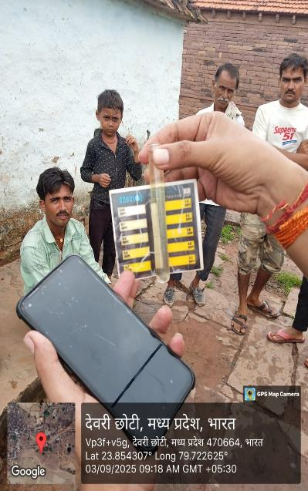
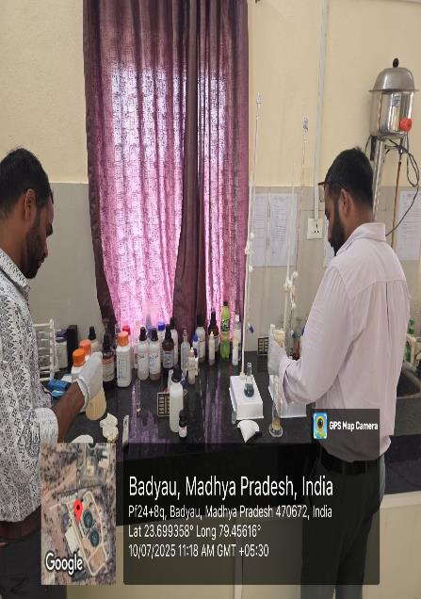
Nirmal Module – Water Quality Monitoring

Slide 25
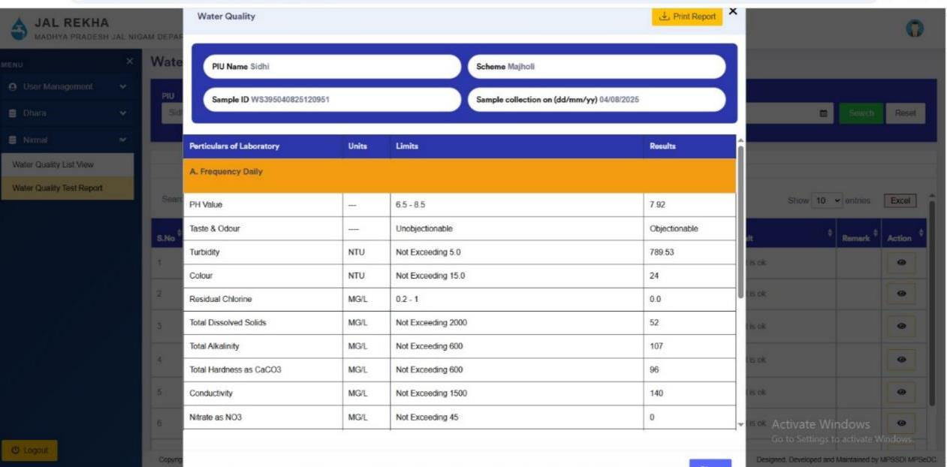
Nirmal Module – Water Quality Monitoring

Slide 26
Bharosa – Pre-dispatch material inspection by TPIA
“Bharosa” module to be developed:
QAPs: Uploading approved Quality Assurance Plans (QAPs) for all material to be procured.
Material Testing Record Keeping: The module facilitates recording comprehensive pre-dispatch material testing details to ensure quality and compliance with standards.
Real-Time Updates: Provides real-time notifications and updates on testing results, enhancing transparency and decision-making.
Streamlined Process: Integrates seamlessly with existing workflows, improving efficiency in the material dispatch process and reducing delays.

Slide 27
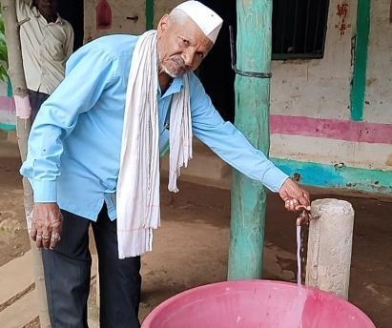



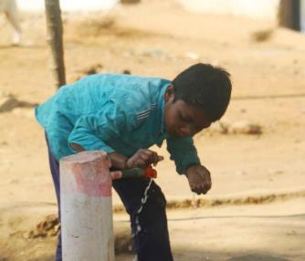
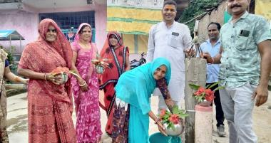
जल जीवन मिशन के जतन का फल।
घर-घर पहुँचे निर्मल जल।।

Slide 28
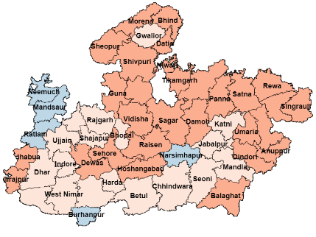
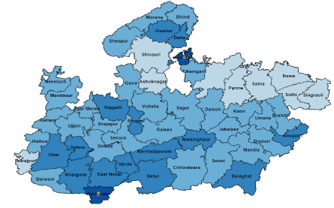
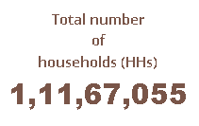




Progress since launch of Jal Jeevan Mission in Madhya Pradesh
As on 15.08.2019
As on 16.11.2025
 | More than 75%
 | 51 to 75%
 | 26 to 50%
 | 11 to 25%
 | 0 to 10%
Progress – 70.52%
More than 70% rural families in the state are getting tap water.

Slide 29

Coverage of Surface Water-based Scheme
100% MVS Coverage
Neemuch
Mandsaur
Ratlam
Alirajpur
Barwani
Agar
Shajapur
Sehore
Burhanpur
Vidisha
Ashok Nagar
Sheopur
Niwari
Jabalpur
Damoh
Panna
Satna
Rewa
Sidhi
Singrauli
Dindori

Slide 30


